Slide 1

Computational Session II- RNA-Seq Analysis
art of trying to make one
BIG thing from millions of
very small things
Instructor : Kritika Karri
kkarri@bu.edu

Slide 2
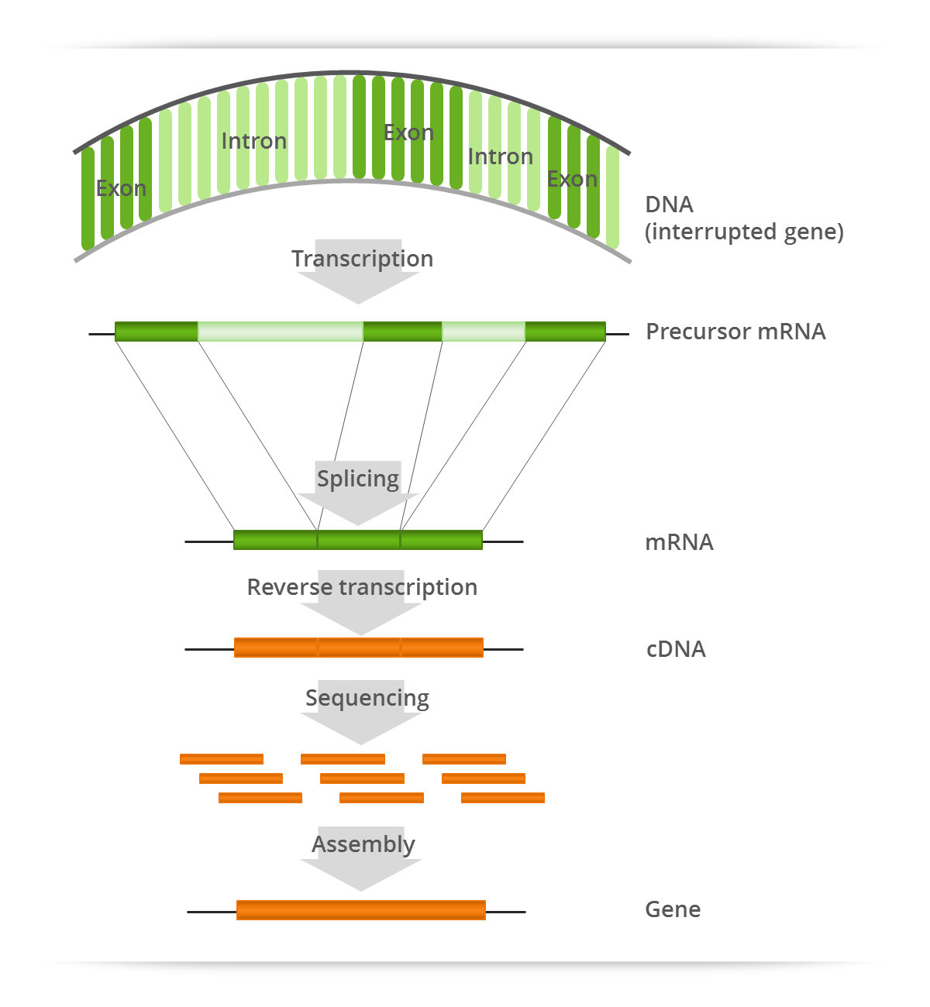
Transcriptome
Genome may be constant but an experimental condition has a pronounced effect on gene expression
Entire set of RNA transcripts in a given cell for a specific developmental stage or physiological condition to study
  functional elements of the genome
  understanding mechanisms of development and disease.
Microarray used for large-scale RNA-level studies to
  identify DE genes between conditions.
  BUT hybridization- based nature limits the ability to catalog and quantify RNA molecules expressed under various conditions.

Slide 3
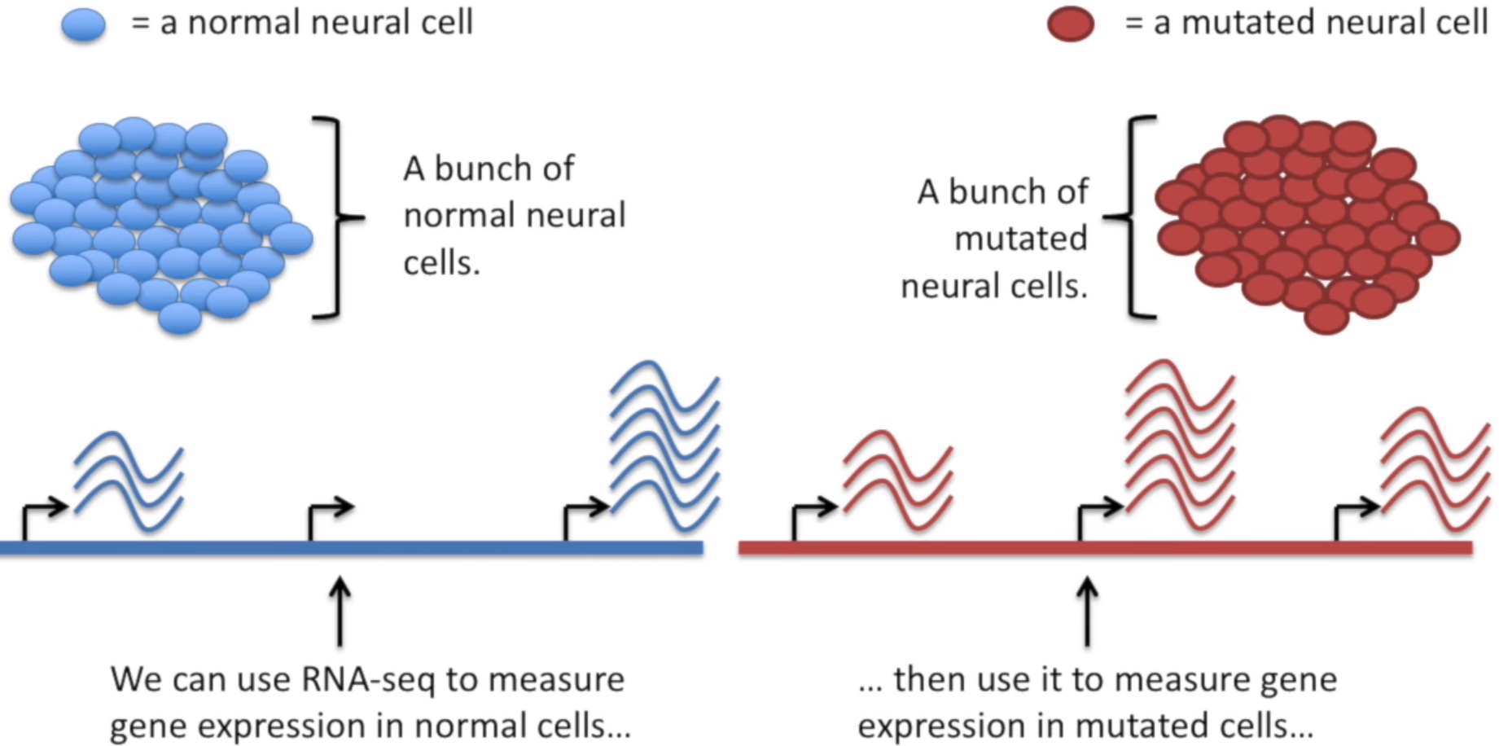
What is RNA-Seq Analysis
Transcriptome sequencing (RNA-seq) by sequencing of cDNA.
RNA-seq produces millions of sequences from complex RNA samples. With this powerful approach, you can:
  Measure gene expression.
  Discover and annotate complete transcripts.
  Characterize alternative splicing and polyadenylation.
Notes:
Within the organisms, genes are transcribed and spliced (in eukaryotes) to produce mature mRNA transcripts (red). The mRNA is extracted from the organism, fragmented and copied into stable ds-cDNA (blue). The ds-cDNA is sequenced using high-throughput, short-read sequencing methods. These sequences can then be aligned to a reference genome sequence to reconstruct which genome regions were being transcribed. This data can be used to annotate where expressed genes are, their relative expression levels, and any alternative splice variants.

Slide 4
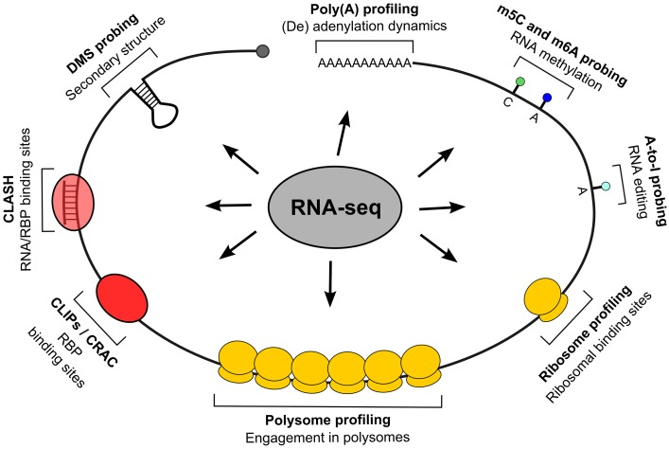
Applications of RNA-Seq
Functional studies
  Drug treated vs. untreated cell line or Wild type (WT) versus knock-out (KO) mice
Some molecular features can only be observed at the RNA level
  Alternative isoforms, fusion transcripts, RNA editing, lincRNA discovery
Interpreting mutations that do not have an obvious effect on protein sequence
  ‘Regulatory’ mutations that affect what mRNA isoform is expressed and how much
Notes:
Genome may be constant but an experimental condition has a pronounced effect on gene expression

Slide 5
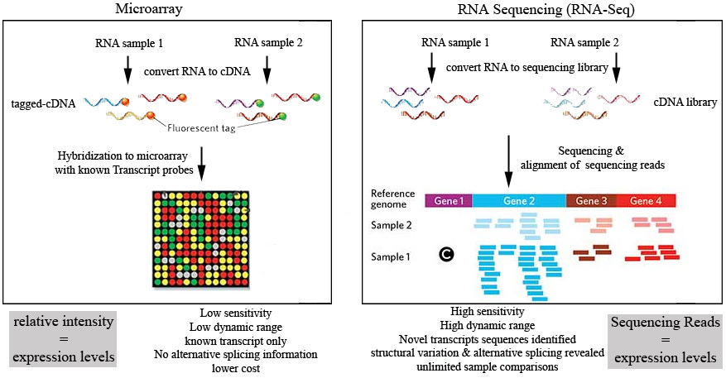
RNA-Seq vs Microarray
Notes:
Unbiased detection of novel transcripts: Unlike arrays, RNA-Seq technology does not require species- or transcript-specific probes. It can detect novel transcripts, gene fusions, single nucleotide variants, indels (small insertions and deletions), and other previously unknown changes that arrays cannot detect.
Broader dynamic range: With array hybridization technology, gene expression measurement is limited by background at the low end and signal saturation at the high end. RNA-Seq technology quantifies discrete, digital sequencing read counts, offering a broader dynamic range.
Increased specificity and sensitivity: Compared to microarrays, RNA-Seq technology offers increased specificity and sensitivity, for enhanced detection of genes, transcripts, and differential expression.
Easier detection of rare and low-abundance transcripts: Sequencing coverage depth can easily be increased to detect rare transcripts, single transcripts per cell, or weakly expressed genes.

Slide 6
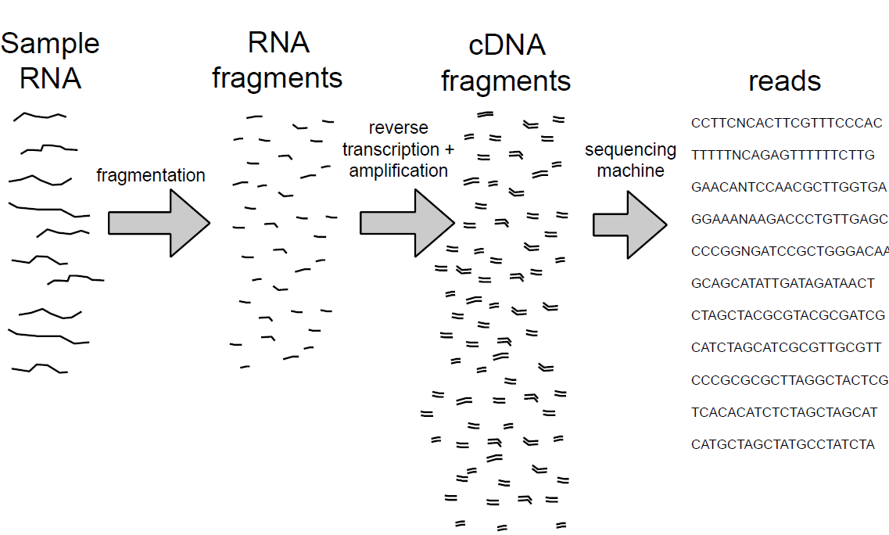
RNA Seq Experimental Protocol Overview

Slide 7
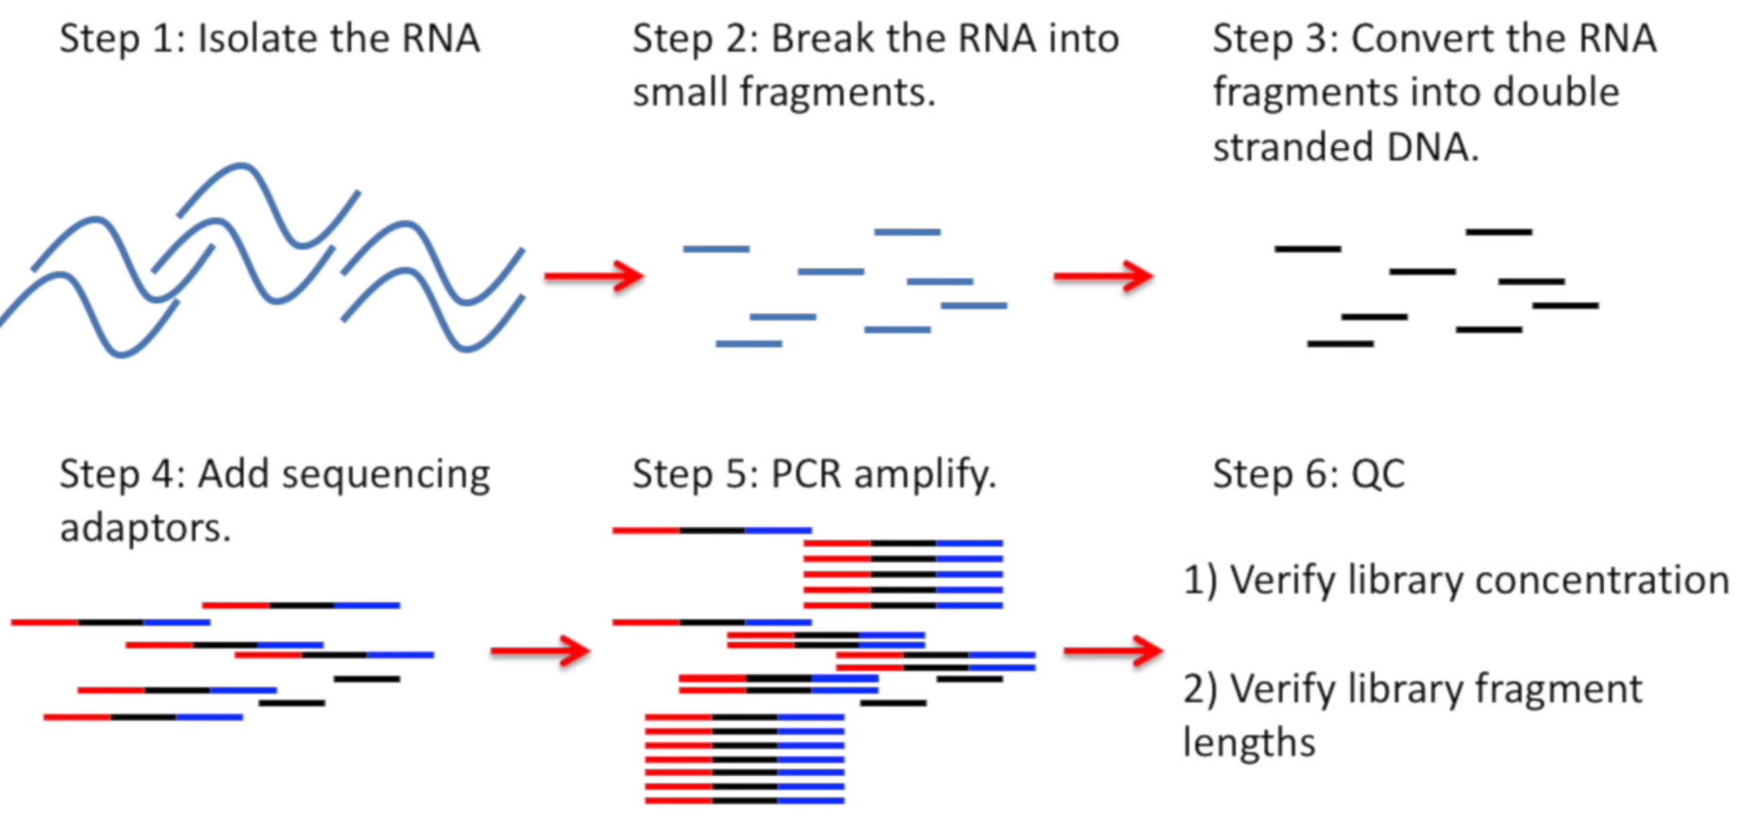
Preparing a RNA-Seq Library
Notes:
Note: Illumina Protocol is widely used for sequencing the reads but there are other protocols and sequencers that do it differently.

Slide 8
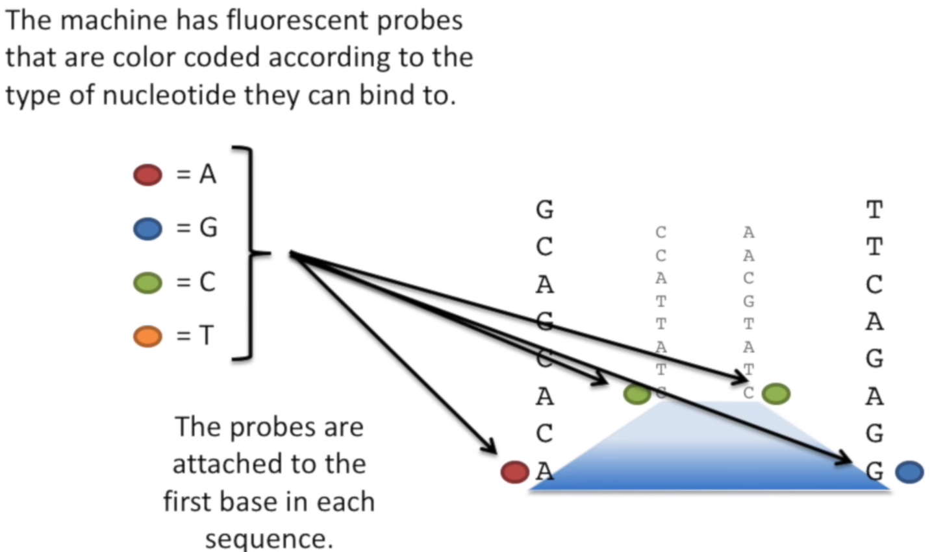
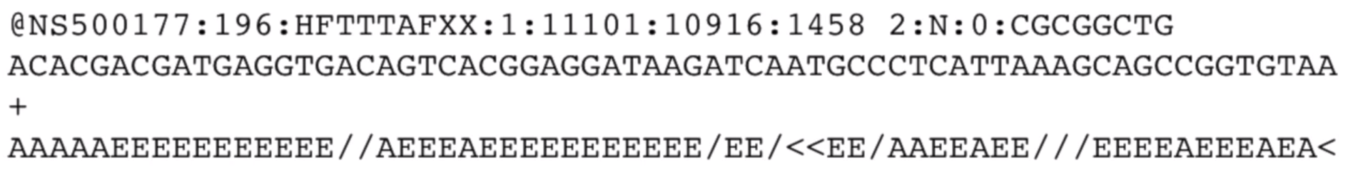
Sequencing Library - Illumina Sequencing
https://youtu.be/womKfikWlxM?list=PLfswlygMuYWLDnezvdq8rKyY4xtjCPig4
RAW DATA: Reads in fastq.gz

Slide 9
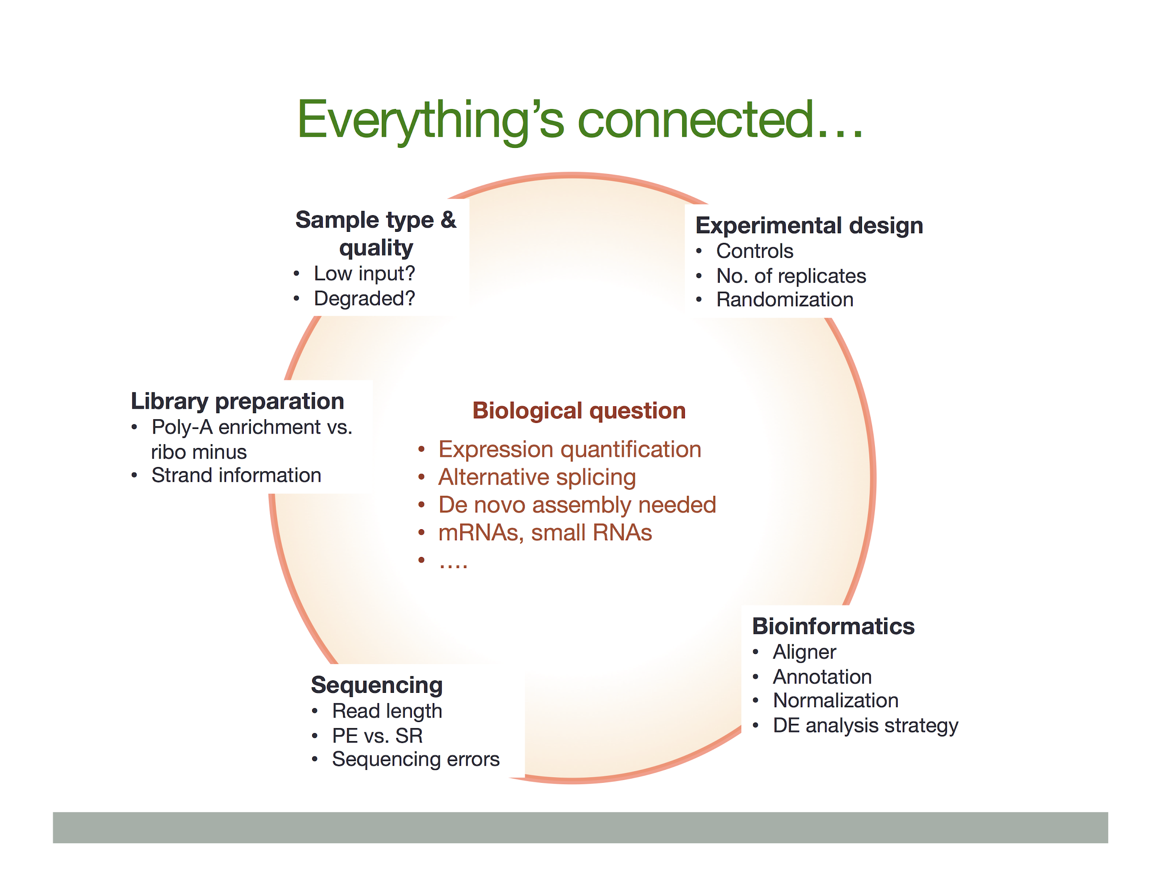
Design Concepts
Single vs Paired End Reads:
Ideal Read Length :Longer reads can provide more reliable information about the relative locations of specific base pairs.
  Gene Expression: short single reads (50-75bp)
  Novel Transcriptome Assembly and annotation project: Longer paired end reads ( 2x 75 bp)
  Small RNA Analysis : Usually 50 bp read covers the entire sequence.
Stranded vs Unstranded
Replicates
  At least three Biological Replicate min for DE Analysis.
Notes:
Gene expression / RNA Profiling – Quantifying the coding transcriptome typically requires a short single read (often 50–75 bp) to minimize reading across splice junctions while counting all RNAs in the pool.
Transcriptome Analysis – Novel transcriptome assembly and annotation projects tend to benefit from longer, paired-end reads (such as 2 x 75 bp) to enable more complete coverage of the transcripts and identification of novel variants or splice sites. Paired-end reads are required to get information from both 5’ and 3’ ends of RNA species with Stranded RNA-Seq library preparation kits.
Small RNA Analysis – Due to the short length of small RNA, a single read (usually a 50 bp read) usually covers the entire sequence. A read length of 50 bp sequences most small RNAs, plus enough of the adapter to be accurately identified and trimmed during data analysis.

Slide 10
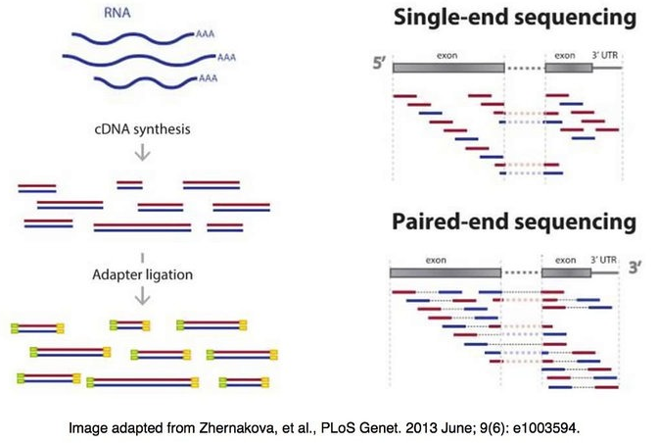
Single-end vs. paired-end reading
  SE : sequencer reads a fragment from only one end to the other, generating the sequence of base pairs.
  PE: sequencing starts at one read, finishes this direction at the specified read length, and then starts another round of reading from the opposite end of the fragment.
  ability to identify the relative positions of various reads in the genome, making it much more effective than single-end reading in resolving structural rearrangements such as gene insertions, deletions, or inversions.
  improve the assembly of repetitive regions.
    paired-end reads are more expensive and time-consuming to perform.

Slide 11
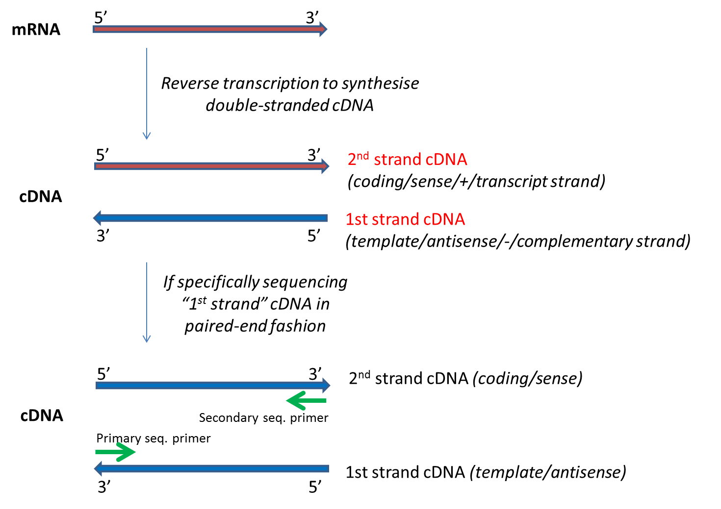
Stranded vs. Unstranded
unstranded RNAseq called fr-unstranded in TopHat/Cufflinks jargon);
Library Strand: whether the 'first strand' or 'second strand' of cDNA was used to prepare the library.
NOTE: Different from single vs paired end
"First strand" corresponds to the "template"/ "antisense" / "-" strand and has the reverse complement sequence of the transcribed mRNA. (dUTP protocol or Illumina TrueSeq RNAseq kits)
“Second strand" corresponds to the "coding" /"sense" /"+" strand which has the same sequence as the RNA that is transcribed.
  For paired-end strand-specific sequencing studies, sequencing the 'first strand" is sometimes referred to as "mate2_sense" (i.e. mate 2 of the paired-end reads comes from the sense strand).

Slide 12
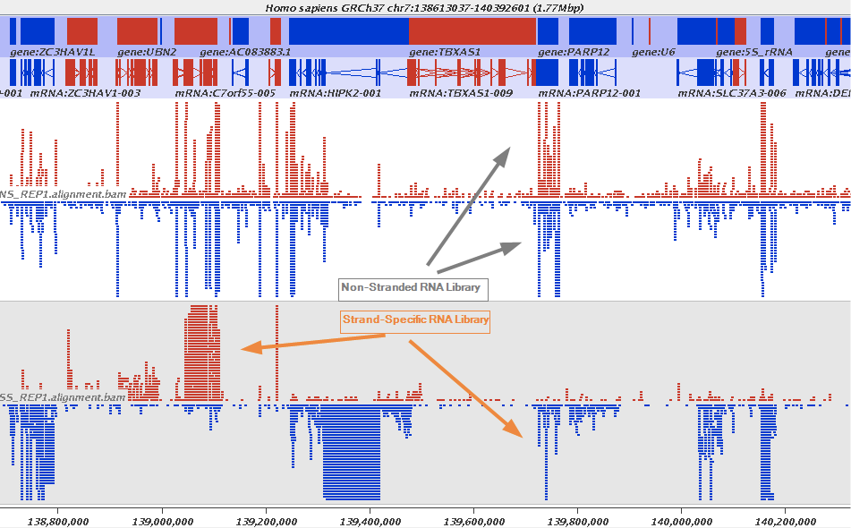
Design Concepts - Stranded vs unstranded
stranded RNAseq can distinguish whether the reads are derived from forward- or reverse-encoded transcripts.
Notes:
RNAs that are typically targeted in RNAseq experiments are single stranded (e.g., mRNAs) and thus have polarity (5' and 3' ends that are functionally distinct): During a typical RNAseq experiment the information about strandedness is lost after both strands of cDNA are synthesized, size selected, and converted into sequencing library. However, this information can be quite useful for various aspects of RNAseq analysis such as transcript reconstruction and quantification.
stranded RNAseq is that you can distinguish whether the reads are derived from forward- or reverse-encoded transcripts:

Slide 13
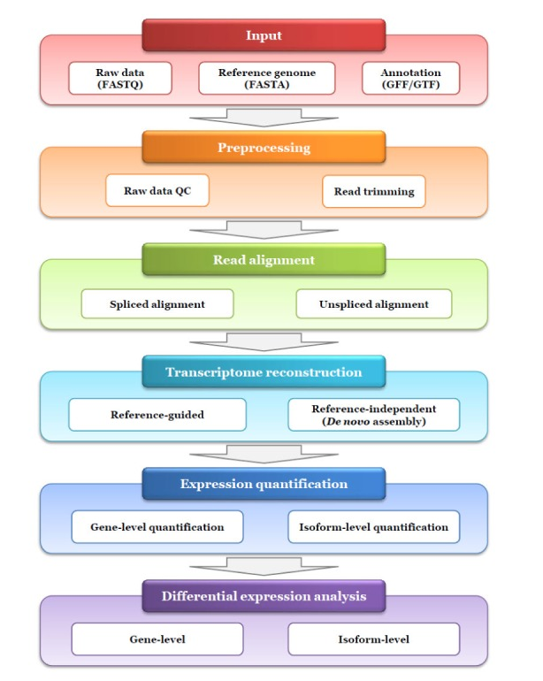
Overview of RNA Seq Analysis
RNA seq data can be used to address a variety of biological problems.
The analysis, tools, and methods can different depending on the problem of study.
Useful Review for different RNA Seq Tools : http://www.rna-seqblog.com/review-of-rna-seq-data-analysis-tools/
Notes:
Overview slides

Slide 14
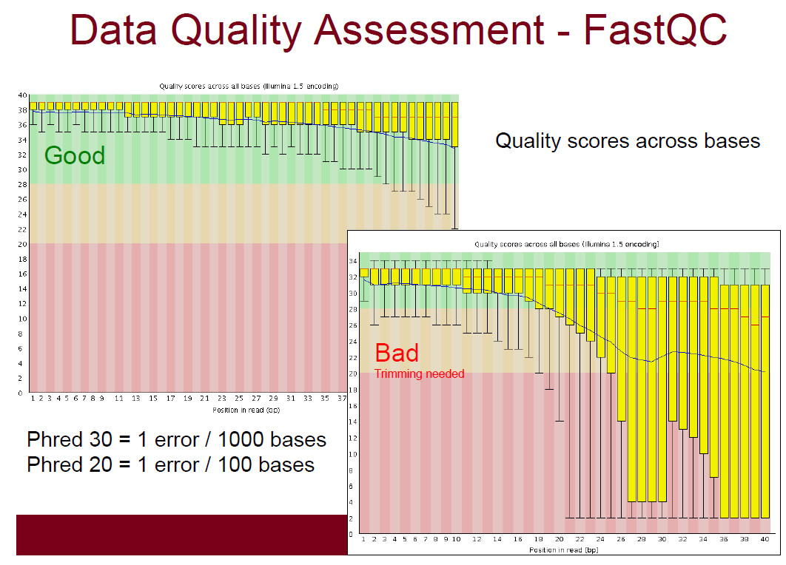
Notes:
The central red line is the median value
The yellow box represents the inter-quartile range (25-75%)
The upper and lower whiskers represent the 10% and 90% points
The blue line represents the mean quality
The y-axis on the graph shows the quality scores. The higher the score the better the base call. The background of the graph divides the y axis into very good quality calls (green), calls of reasonable quality (orange), and calls of poor quality (red). The quality of calls on most platforms will degrade as the run progresses, so it is common to see base calls falling into the orange area towards the end of a read.

Slide 15
Data Quality Assessment: Trimming
Adaptor Trimming:
  May increase mapping rates
  Absolutely essential for small RNA
  Improves de novo assemblies
    Trim Galore! uses the first 13 bp of Illumina standard adapters ('AGATCGGAAGAGC') by default (suitable for both ends of paired-end libraries), but accepts other adapter sequence, too
Quality Trimming:
  May increase the mapping rates
  Loss of information
Lots of software doing either of these or both. Eg. Cutadapt, Trim Galore!, PRINSEQ, Trimmomatic, Sickle/Scythe, FASTX Toolkit, etc.

Slide 16
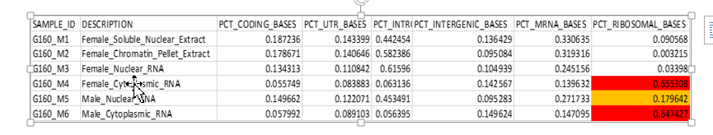
RNA Seq Specific QC
Several intrinsic biases and limitations including nucleotide composition bias, GC bias and ribosomal contamination (fig) can be introduced to RNA-seq data of clinical samples with low quality or quantity.
RSeQC provides metrics containing:
  sequence quality, GC bias, polymerase chain reaction bias, nucleotide composition bias, sequencing depth, strand specificity, coverage uniformity, and read distribution over the genome structure.
  sequencing depth determines if current RNA-seq data is suitable for expression profiling, alternative splicing analysis, novel isoform identification, and transcriptome reconstruction.
Other tools : RNA-SeQC, Qualimap2,etc.

Slide 17
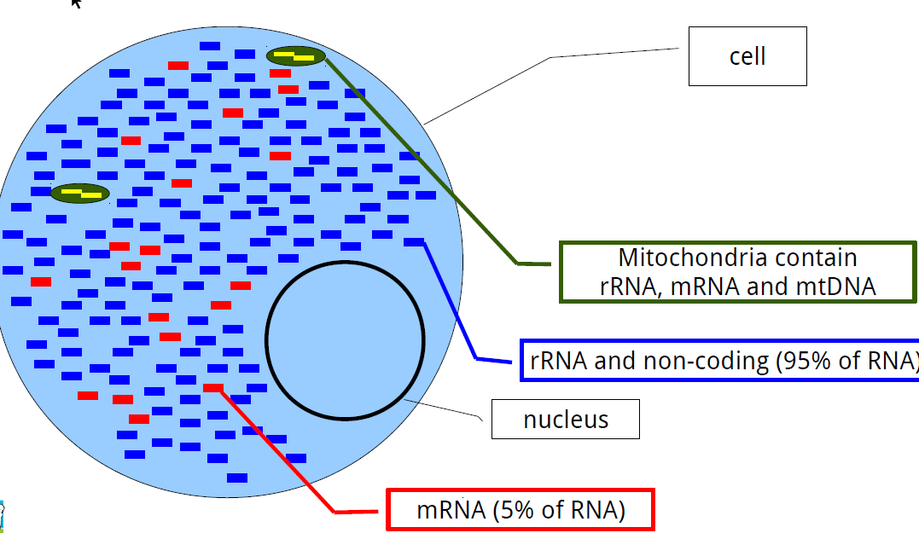
Design Choice: Ribosomal RNA Depletion
95% of RNA molecules in the cell are ribosomal RNA (rRNA)
These molecules are useless for transcriptomics
Must deplete rRNA species to capture other types of RNA transcripts
Two strategies to select for non-rRNA species:
  poly-A selection: capture RNA molecules with 3’ poly-A tail
  Ribo-depletion: cDNA probes for specific rRNA sequences captured by special streptavidin-coated beads

Slide 18
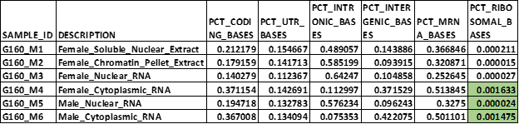
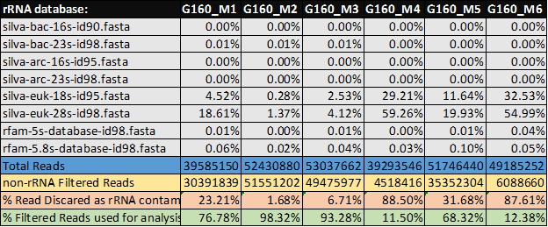
Ribosomal contamination - SortMeRNA
SortMeRNA is a program tool for filtering ribosomal RNA from metatranscriptomic data.

Slide 19
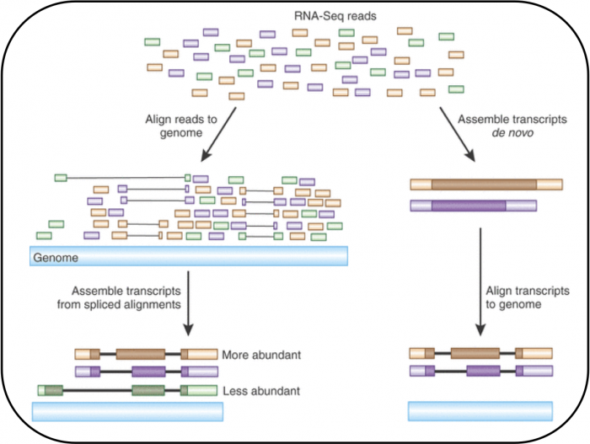
Read Alignment
After sequencing is performed you have a collection of sequencing reads for each sample/replicate. In a reference-based RNAseq experiment these need to be mapped against the genome.
Tophat: Analyzes the mapping results to identify splice junctions between exons.
Other aligners : Spliced Transcripts Alignment to a Reference (STAR) , HISAT

Slide 20
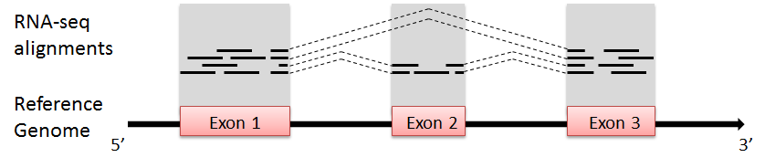
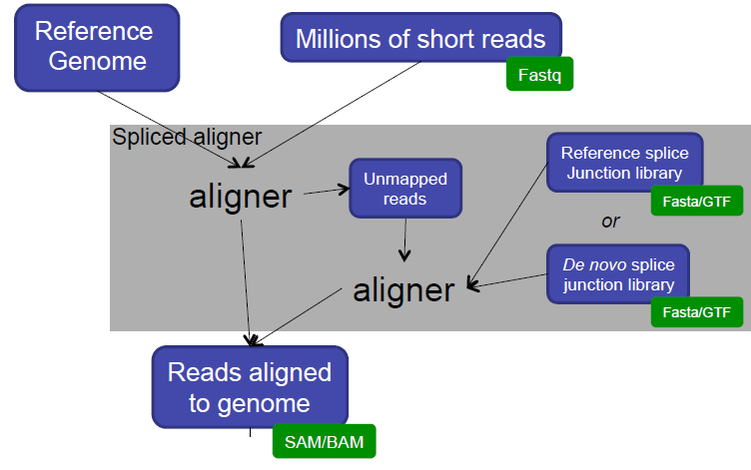
Which Mapping Strategy to use?
Depends on read length
  < 50 bp reads
    Use aligner like BWA and a genome + junction database
    Junction database needs to be tailored to read length
  > 50 bp reads
    Spliced aligner such as Bowtie/TopHat, STAR, HISAT, etc.

Slide 21
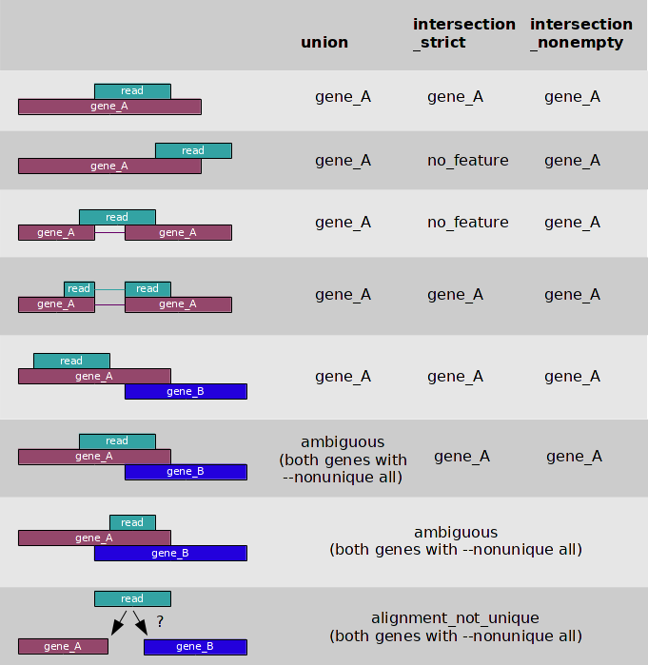
Read Counting (Quantification)
The simplest approach to quantifying gene expression by RNA-seq is to count the number of reads that map (i.e. align) to each gene (read count) using programs such as HTSeq-count or featureCount.
This gene-level quantification approach utilises a gene transfer format (GTF) file containing gene models, with each model representing the structure of transcripts produced by a given gene.
htseq-count strategies
Notes:
Show an example of HTSeq counting results

Slide 22

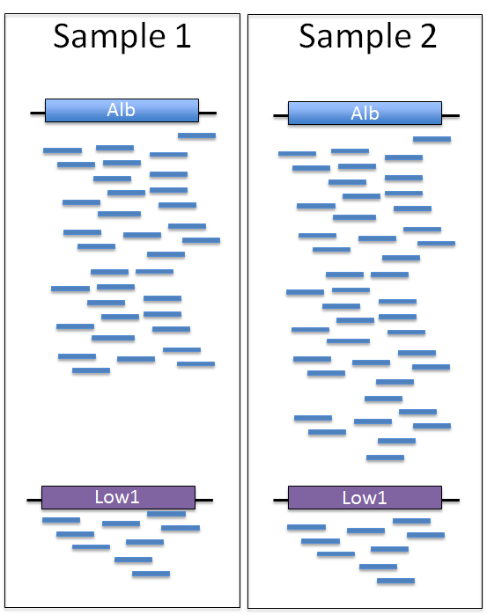
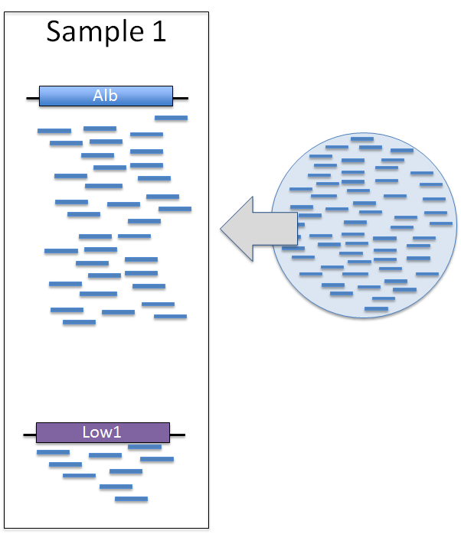
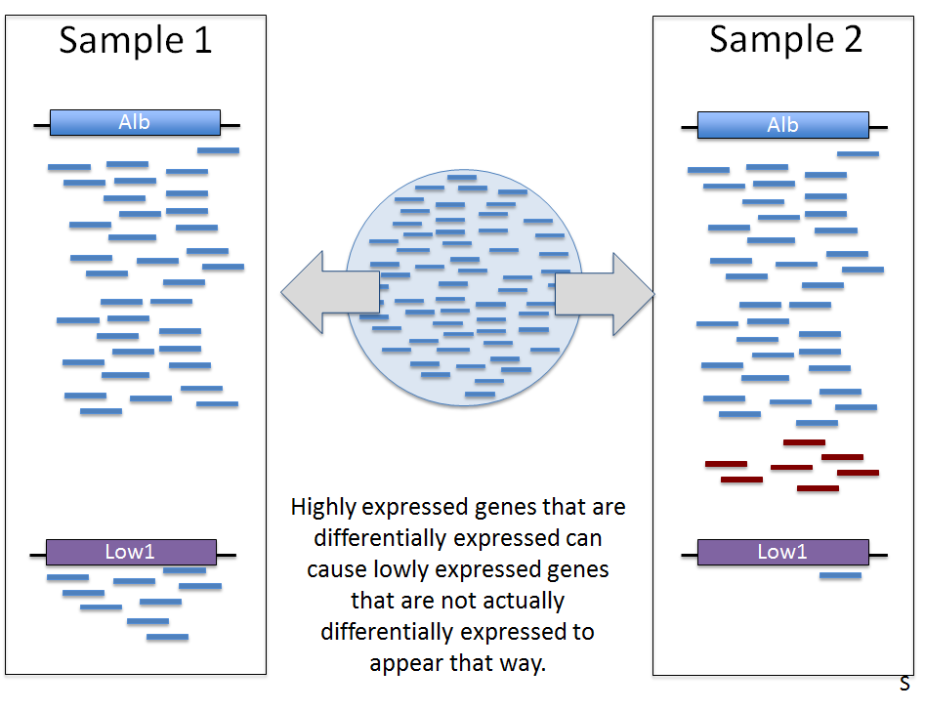
Normalisation
Finite Reads
In perfect world all transcripts are counted
In real world, ,ore reads taken up by highly expressed genes means less reads available for lowly expressed genes.
Highly expressed genes that are differentially expressed can cause lowly expressed genes that are not actually differentially expressed to appear that way.
Notes:
Higher expressed Albumin in sample 2 sucks up the reads that would have gone to Low1, making Low1 appear to be differentially expressed between the samples.

Slide 23
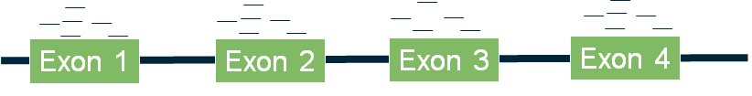
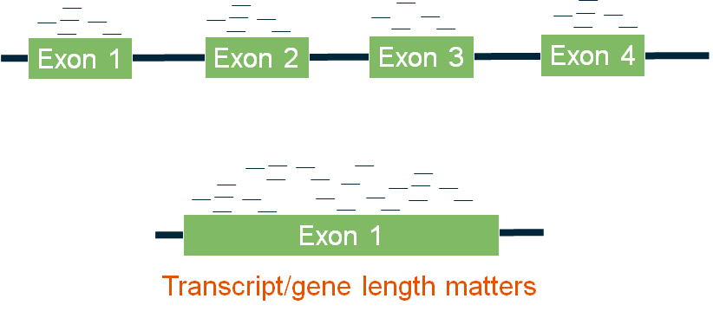
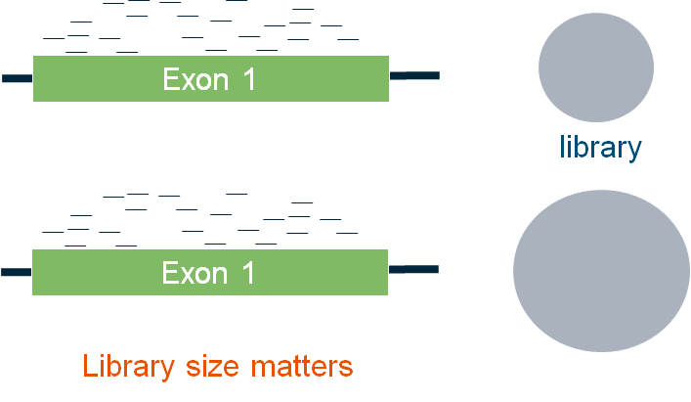
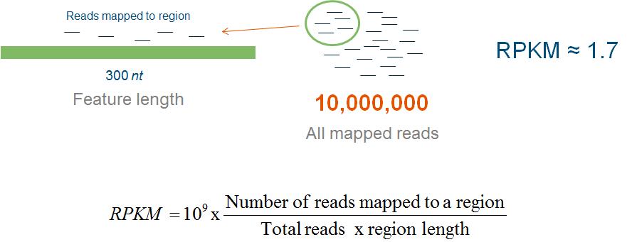
Raw Read Counts and Normalizing/correcting for feature length and library size
Counting number of reads/fragments falling with exonic regions of a gene. Example: HTseq-count.
The same fragment count yet different expression levels.

Slide 24
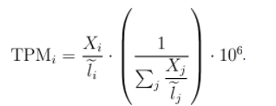
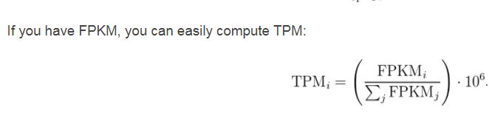
TPM: Transcripts per Million
TPM is the number of transcripts you would have seen of type , given the abundances of the other transcripts in your sample

Slide 25
Normalization Summary with Goals
R/FPKM: (Mortazavi et al. 2008)
  Correct for: differences in sequencing depth and transcript length
  Aiming to: compare a gene across samples and diff genes within sample
TMM: (Robinson and Oshlack 2010)
  Correct for: differences in transcript pool composition; extreme outliers
  Aiming to: provide better across-sample comparability
TPM: (Li et al 2010, Wagner et al 2012)
  Correct for: transcript length distribution in RNA pool
  Aiming to: provide better across-sample comparability
Limma voom (logCPM): (Lawet al 2013)
  Aiming to: stabilize variance; remove dependence of variance on the mean
Relative Log Expression(RLE)
  normalization (RLE) implemented in the DESeq2 package

Slide 26
RNASeq Analysis: Differential Expression

Slide 27
Differential expression analysis
Take the normalised read count data and performing statistical analysis to discover quantitative changes in expression levels between experimental groups.
The goal of differential expression analysis (DE) is to find gene (DGE) or transcript (DTE) differences between conditions, developmental stages, treatments etc. In particular DE has two goals:
  Estimate the magnitude of expression differences (Fold Change FC);
  Estimate the significance of expression differences. (p-value, FDR)
Accurately determining the variation requires many biological samples (replicates).
Notes:
Relative comparison : One compared to the other.

Slide 28
Differential Expression Analysis
Cuffdiff
    Genome annotation based
    FPKM values
    Numerical method for finding the maximum likelihood optimum
    *Obsolete
EdgeR
    Complex experimental designs using generalised linear model (GLM)
    Negative binomial distribution, similar to DESeq2
DESeq
    Differential gene expression analysis based on the negative binomial distribution
Ballgown
    visualize the transcript assembly on a isoform level
    extract abundance estimates for exons, introns, transcripts or genes
    perform linear model–based differential expression analyses.

Slide 29
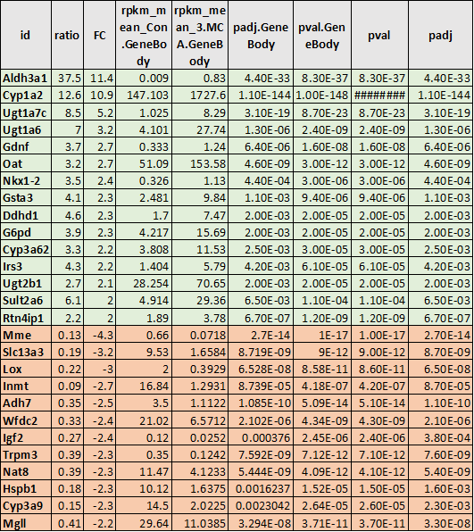
Obtain a list of significant DE Genes
Typical RNA-Seq dataset will have counts for ~20k genes.
Adjusted p-values account for the chance that gene counts are different across samples by chance
All tested genes have:
  p-value
  Effect size (test statistic or fold change)
Significant DE genes have an adjusted p-value less than a given threshold (e.g. p-adj < 0.05)

Slide 30
RNASeq Analysis: Transcriptome Assembly

Slide 31
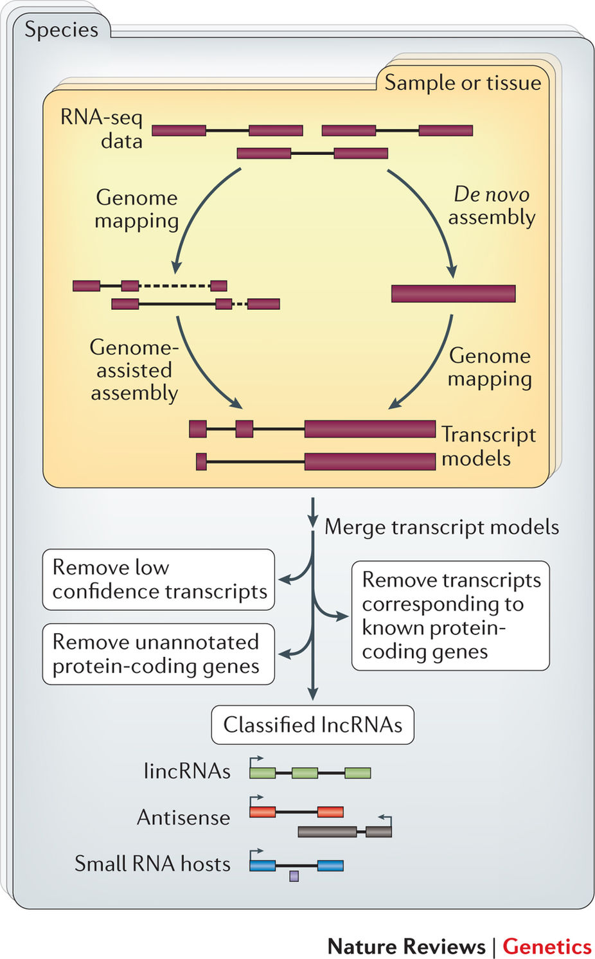
Transcript Reconstruction
Transcript Reconstruction: The splices exons information generated from read alignment step is used to build transcript models.
  De novo
  Genome Guided
Cufflinks: assembles the alignments into a parsimonious set of transcripts and estimates the relative abundances of these transcripts.
Stringtie: Assembles transcripts from spliced read alignments produced by tools such as STAR, TopHat, or HISAT and simultaneously estimates their abundances using counts of reads assigned to each transcript.
Notes:
Basic quantification algorithm
•Align reads against a set of reference transcript sequences
•Count the number of reads aligning to each transcript
•Convert read counts into relative expression levels
The previous step - mapping - assigns RNAseq reads to genomic locations and identifies splice junctions from reads that originate from different exons. At transcript reconstruction step this information is taken further in attempt to build transcript models. There is a number of tools for performing this task.

Slide 32
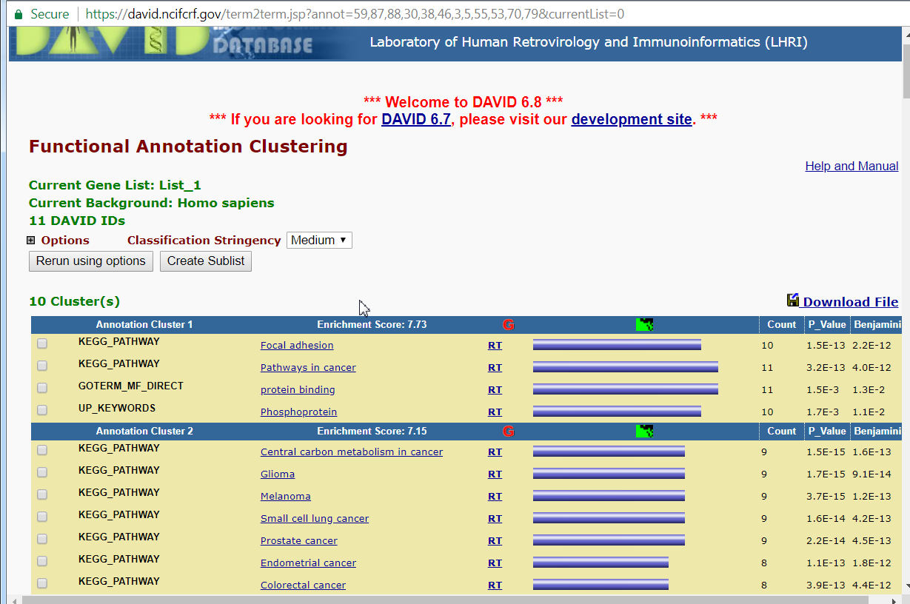
What can we do with DE genes ?
Pathway Enrichment: Utilises the enriched list of genes and see their enrichment across different functional pathways.
  DAVID : https://david.ncifcrf.gov/home.jsp
Notes:
List of gene for david demonstration : AKT1,AKT2,JUN,PDGFRB,PIK3CA,PIK3CB,PIK3CD,PIK3CG,PTEN,PTK2,TP53

Slide 33
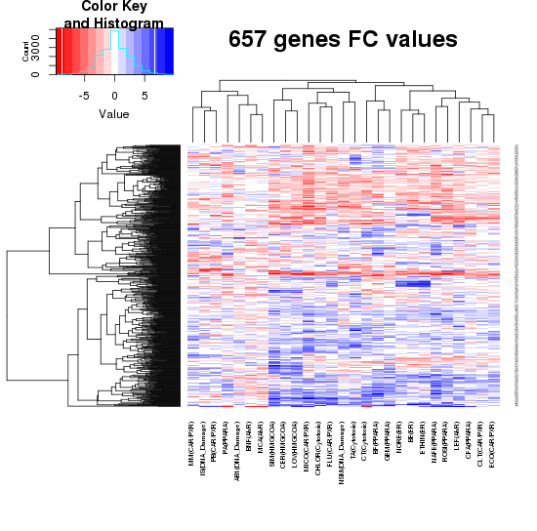
Clustering Heatmaps for DEG for Different Conditions

Slide 34
Other Application of RNA-Seq
LnncRNA discovery: Long non coding RNA
  Using the cufflinks and cuffmerge program for transcriptome assembly.
  The assembled transcriptome file can be used to detect lincRNA.

Slide 35
Challenges
The reads are much shorter than the transcripts from which they are derived.
Tasks with RNA-Seq data thus require handling hidden information: which gene/isoform gave rise to a given read.
Sample : Purity, ribosomal contiminal, quality etc.
RNAs consist of small exons that may be separated by large introns
  Mapping reads to genome is challenging
RNAs come in a wide range of sizes
  small RNAs must be captured separately
  PolyA selection of large RNAs may result in 3’ end bias
RNA is fragile compared to DNA (easily degraded)

Slide 36
Hands-on session
Copy the sample.txt file created in the last session to waxmanlab project folder.
Copy the scripts folder from : /restricted/projectnb/waxmanlab/routines/RNASeq_Paired_End_v2.3.0/ to your folder created in waxmanlab

